Slide 1
Chapter 12
Lateralization and Language

Slide 2
Why does hemispheric lateralization exist?
Left hemisphere
Language – grammar and vocabulary
Logical, analytical thinking
Right hemisphere
Intonation and accentuation
Emotional aspects of language
Spatial manipulation, facial comprehension and creative abilities
Two hemispheres are differently specialized in the processing of segmental features of language

Slide 3
Handedness
90% right handed
70% of left handed are left hemisphere dominant for language
Genetics – important factor

Slide 4
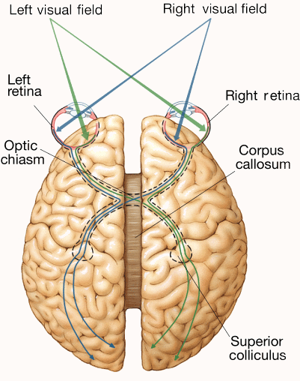
Split-brain patients
Commissurotomy – section of corpus callosum
Behave as if 2 brains
Humans to control spread of seizures

Slide 5
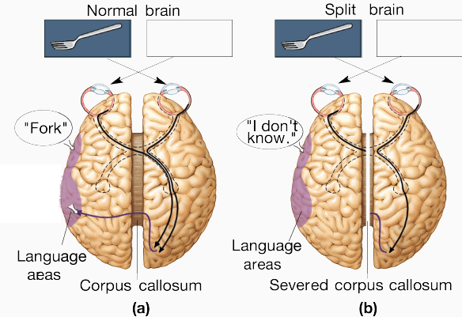
Split-brain studies with humans
Left hemisphere – language & analytical functions
Right hemisphere – non-verbal & visual-spatial functions
Left-hemisphere dominance of language
With tachistoscope presentation of stimuli
Could not verbally name stimuli in left field
Ability to name objects – left hemisphere

Slide 6
The structure of language
Morphology – the rules for combining words to make longer words are specified by morphology, the addition of suffixes and prefixes
Phonology – dictates the regulations involved when sound elements and phonemes are combined in order to form words
Prosody – consists of the arrangement of intonation and stress which, for instance, lets us recognize questions from statements
Syntax – dictates the way in which words combine to make phrases and sentences in order to make the meaning clear

Slide 7
Involvement of the right hemisphere in language
Prosody
Prosody of language refers to the pitch, volume, rate and tempo of speech (Pell, 2006)
Disorder termed aprosodia

Slide 8
Is language innate or do we learn it?
Noam Chomsky
Language Acquisition Devise (LAD)
If left hemisphere is removed as an infant, language functions will develop entirely within the right hemisphere
From nurture standpoint, there appears to be a critical period for language acquisition

Slide 9
When was language first produced?
The use of language may have started as far back as 2 million years ago (Corballis, 2009)
The recent discovery of the FOXP2 gene
The FOX2P gene is necessary for speech and it has a role to play in our fine motor control
FOX2P – the language gene ????

Slide 10
Speech production
Broca (1861)
Man named Leborgne, who comprehended language but was unable to produce speech
He could only produce a single repetitive syllable, ‘tan’
Leborgne died of his ailments several days later
The area that was damaged in Leborgne is now known as Broca's area
Broca’s aphasia

Slide 11
Broca aphasia
Non-fluent aphasia
Damage to anterior areas of the brain, including but not limited to the left posterior inferior frontal gyrus called Broca's area (Brodmann area 44 and Brodmann area 45)
Most common cause of Broca's aphasia is the result of a stroke

Slide 12
Wernicke’s aphasia
Wernicke’s area
Damage to this area results in a person not being able to understand language instead of not being able to speak
Lesions in Wernicke’s aphasia are traditionally located as the posterior section of the superior temporal gyrus (STG) in the left cerebral hemisphere
Brodmann area 22

Slide 13
Lateralization of brain function
Individuals with Wernicke’s aphasia can speak fluently with usual grammar, syntax, intonation and stress
However, their language content is less meaningful
Paragrammatical speech – substitution of verb tenses or have difficulty using the correct pronoun or preposition
Generally as a result of a stroke

Slide 14
The Wernicke–Geschwind model
Listening – auditory pathways to the primary auditory cortex and on to Wernicke’s area
Speaking – Wernicke’s area to Broca’s area, to the facial area of the motor cortex, and on to the facial motor neurons in the brainstem
Reading – visual areas 17, 18 and 19 to the angular gyrus and on to Wernicke’s area, for silent reading or, in conjunction with Broca’s area, for reading out loud

Slide 15
The bilingual brain
Central issue – whether two different languages are localized in the same area or in distinct areas of the brain
No laterality differences have been found between monolingual speakers and bilingual speakers
Minimal differences in first or second languages localization
Particularly in early speaker of second languages

Slide 16
Communicative disorders: the aphasias
Acquired language impairment
Non-fluent aphasias
Broca’s aphasia – Broca’s area damaged
Inability to initiate well-articulated conversational speech
Speech comprehension is intact
Global aphasia – severe depression of all language function
Transcortical motor aphasia
Not prone to speak
Speech is non-fluent and agrammatical
Good comprehension

Slide 17
Fluent aphasias
Wernicke’s aphasia – Wernicke’s area damaged
Speaks fluently but impaired meaningfulness
Paragrammatic speech – use of inappropriate morphemes
Conduction aphasia – arcuate fasciculus damage
Accurate repetition of short phases
Phonemic paraphasia may be present
Comprehension and conversational speech may be good
Pathophysiology of conduction aphasia remains elusive (Bernal & Ardila, 2009)
Transcortical sensory aphasia – echolalia

Slide 18
Other communicative disorders
Apraxia of speech – due to impaired motor control
Often associated with Broca’s aphasia
Genetic factors playing a role in the disorder (Shriberg et al., 1997)
Auditory-verbal agnosia
Unable to recognize speech as meaningful
Visual-verbal agnosia – problem with printed words
Patients with lesions deep in the left temporal lobe (Gazzaniga et al., 1973)

Slide 19
Reading
Very little conscious effort (Bashir & Hook, 2009)
Imaging studies suggest it starts with activation in pathways that link the primary visual cortex to the posterior inferior temporal cortex (PITC)
Whole word reading seems to follow the ventral or ‘what’ stream to the fusiform gyrus
Phonological reading appears to follow the dorsal or ‘where’ stream to the temporoparietal cortex

Slide 20
Writing
The motor aspects of writing are controlled by the motor cortex with dorsal parietal lobe and the premotor cortex
Evidence also that the left superior parietal lobe is essential for writing (Menon & Desmond, 2001)
Writing involves the posterior inferior temporal cortex (PITC) (Nakamura et al., 2000)
Unable to spell out words phonetically is called phonological dysgraphia and results from damage to superior temporal lobe
Damage to the inferior parietal lobe causes a condition called orthographic dysgraphia or the inability to spell whole words

Slide 21
Disorders of reading and writing
Alexia and agraphia
Alexia – an inability to read
Agraphia – an inability to write
Alexia without agraphia is sometimes referred to as pure alexia
Alexia with agraphia results from damage to the angular gyrus itself and renders the patient unable to read and write (Sakurai et al., 2010)

Slide 22
Disorders of reading and writing
Dysgraphia – difficulty writing
Orthographic dysgraphia – difficulty in using visually based writing and difficulties spelling irregular words
Phonological dysgraphia – can write familiar words but has difficulty writing out unfamiliar words
Orthographic dysgraphia results from damage to the inferior parietal lobe
Phonological dysgraphia is associated with damage to the superior temporal lobe

Slide 23
Dyslexia
Commonly called developmental dyslexia
Defined as an inconsistency between the ability to read and basic intellectual skills in children
Estimates of the population that it affects range from 10 to 30%
4 main theories

Slide 24
Dyslexia – phonological theory
Specifically impaired when attempting to represent, store and/or retrieve word sounds
Grapheme-phoneme correspondence
Neurologically, it is commonly believed that the disorder is caused by a congenital malfunction of left-hemisphere peri-sylvian brain areas (Beland & Mimouni, 2001)

Slide 25
Dyslexia – visual theory
Visual disorder that makes it difficult to process alphabetical letters
Magnocellular pathway is selectively disrupted (Stein & Walsh, 1997)
Deficiencies in visual processing, and to abnormal binocular control
Individuals demonstrate abnormalities in their magnocellular layers of the lateral geniculate nucleus (Livingstone et al. 1991)
A phonological deficiency is not ruled out with the visual theory

Slide 26
Dyslexia – cerebellar theory
Cerebellum of a dyslexic is slightly dysfunctional, resulting in several cognitive deficits (Nicolson et al., 2001)
Observations of insufficient dyslexic performance in several automized and implicit motor tasks (Barnes et al., 2007)
Differences in grey matter volume (Pernet et al., 2009)

Slide 27
Dyslexia – unified theory
Theory that unifies and tries to combine all of the research information that was previously mentioned
Magnocellular dysfunction is not simply restricted to the visual pathways
Generalized to all modalities
Cerebellum is given tremendous information from a variety of magnocellular systems located in the brain
Tries to accounts for every known symptom of dyslexia

Slide 28
Language structure

Slide 29
Anatomy

Slide 30
Disorders

Slide 31
Language

Slide 32
Readings
Barnes, J. (2011). Essential Biological Psychology (Chapter 12). London: Sage.
The Essentials
Chomsky, N. (1986). Knowledge of Language: Its Nature, Origin and Use. New York: Praeger.
Next Steps
Corballis, M.C. (2009). The evolution of language. Annals of the New York Academy of Sciences, 1156, 19-43.
Delving Deeper
Nicolson, R.I., Fawcett, A.J., & Dean, P. (2001). Dyslexia, development and the cerebellum. Trends in Neurosciences, 24(9), 515-516.

